Slide 1
Analysis of Results from Facebook and Twitter Ads

Slide 2
Overview
-Comparison of clicks and link clicks in Facebook and Twitter Ads
-Analysis of Facebook Offline Conversions
-Analysis of Facebook Cost per Conversion
-CTR(Click through rate) Analysis for Facebook and Twitter
-CPC(Cost per Click) Analysis for Facebook and Twitter
-CPLC(Cost per Link Click) Analysis for Facebook and Twitter
- Engagement Rate Analysis for Facebook and Twitter

Slide 3
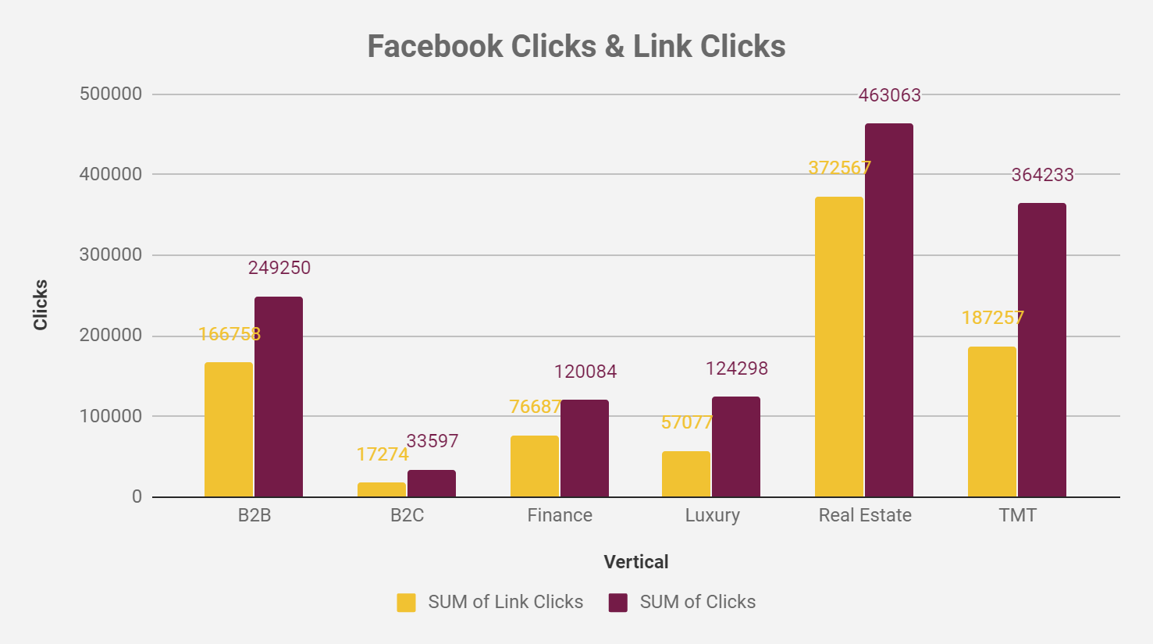
Link clicks versus Clicks for Facebook and Twitter
Notes:
From the charts, In most verticals for facebook, about half of the clicks result in link clicks with the exception being Real estate where clicks and link clicks are relatively close.

Slide 4
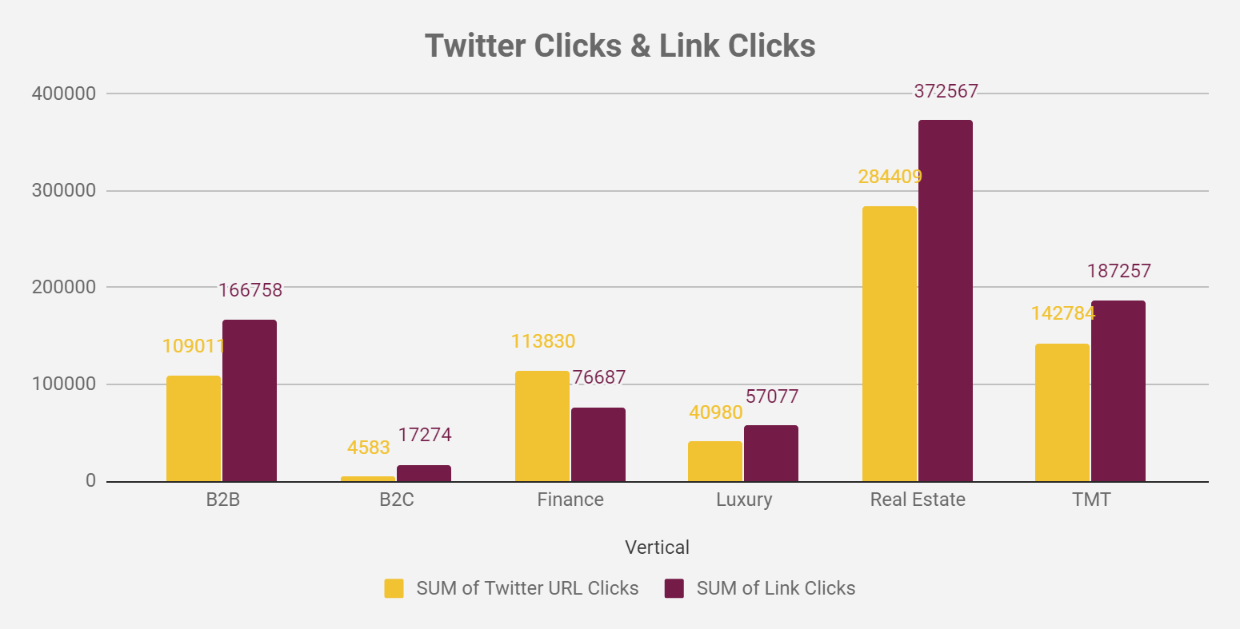
Link clicks versus Clicks for Facebook and Twitter
Notes:
The charts for facebook link clicks & clicks and twitter are similar with real estate being the most interacted with while B2C being the least interacted.
In both facebook and twitter, there are more clicks than link clicks to the landing pages.

Slide 5
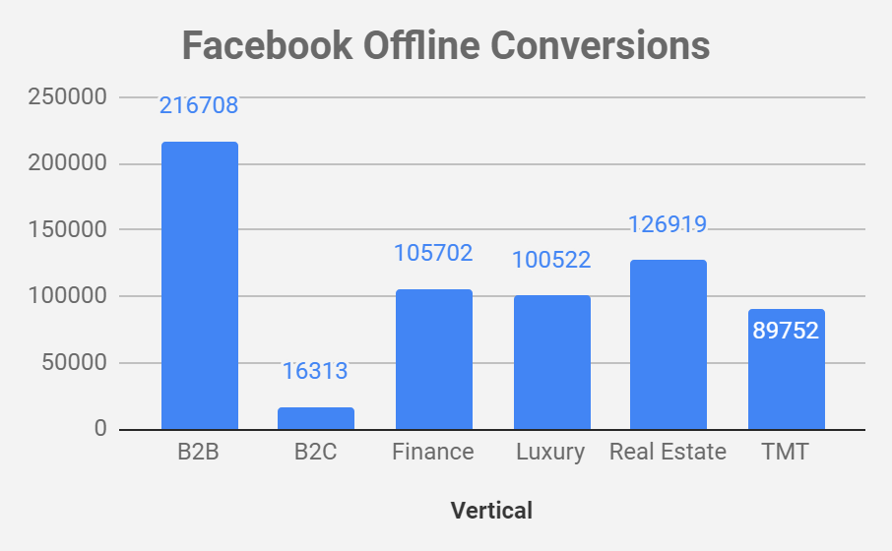
Facebook Offline Conversions
Notes:
From the chart, It’s obvious that vertical B2B has the best offline conversion while B2C has the worst while the rest are mostly similar in the median.

Slide 6
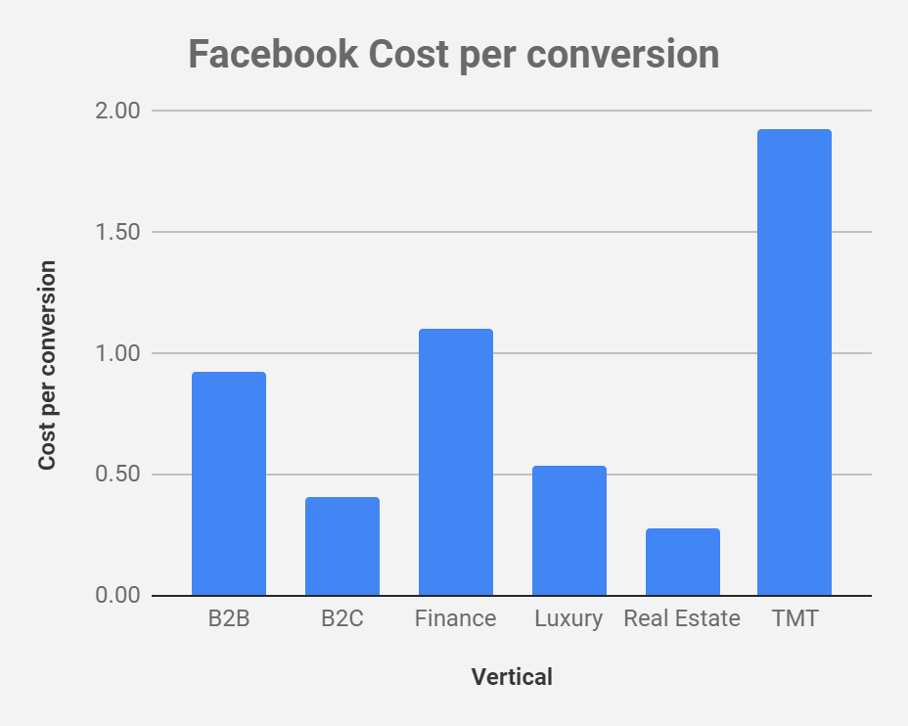
Cost per conversion
Notes:
TMT spends the most per conversion and from the conversion chart, it has the second least conversion number which means they are not maximizing their spend. They could choose to move to twitter or work on their content.
Also worth noting is that B2B has a similar cost per conversion with finance but has the largest conversion magnitude while finance has an average conversion magnitude.
Real Estate with the least cost per conversion has a relatively large amount of conversions.

Slide 7
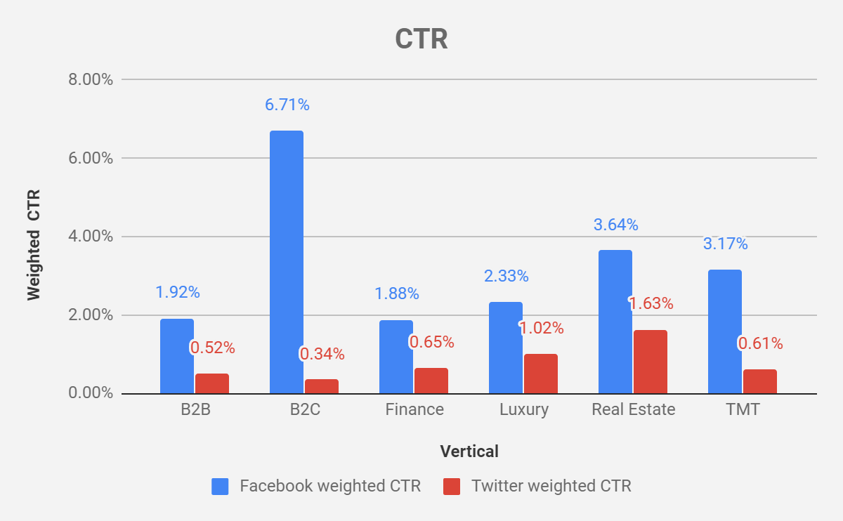
Facebook vs Twitter CTR
Notes:
In all instances, Facebook had a better Click through rate which means there is a higher tendency for the audience to click on the ads of any of the verticals rather than ads on twitter. The large size of B2C’s CTR indicates more people are clicking on their ads on facebook but has the least clicks on twitter similarly.

Slide 8
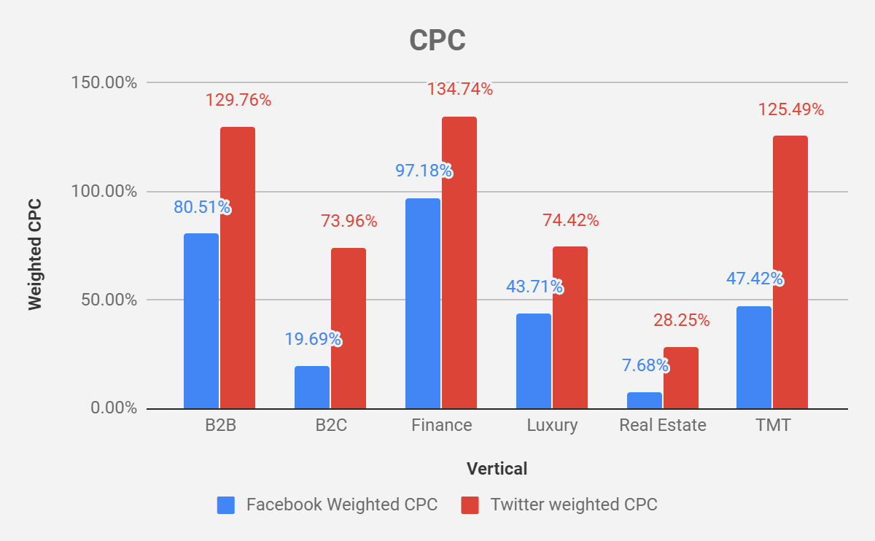
Facebook vs Twitter CPC
Notes:
On all verticals, Facebook has a lower Cost per click(CPC) which will mean facebook has a cheaper rate. Twitter’s cost per click can be 2 or 3 times larger than Facebook’s. Verticals such as TMT, Real Estate and B2C should consider channeling more of their resources into Facebook.

Slide 9
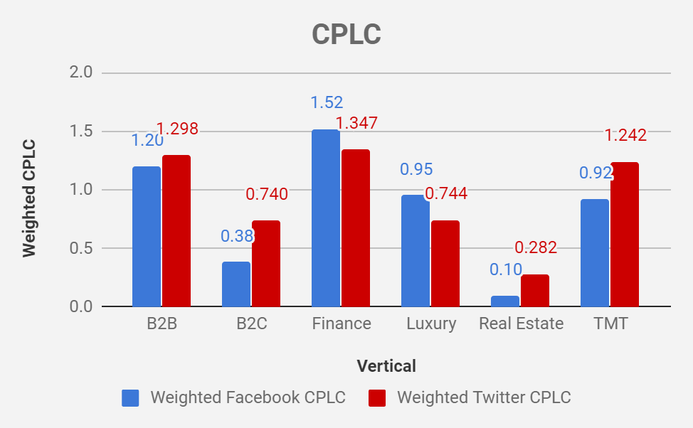
Facebook vs Twitter CPLC
Notes:
The Cost per Link click is divided with verticals such as Finance and Luxury being maximizing utility from Twitter whereas B2B and B2C and TMT having maximum utility from Facebook since it’s CPLC is less.
In order to garner more less expensive link clicks, verticals such as Real Estate and B2C should consider channeling more resources into Facebook since Twitter is about 2 times more expensive.

Slide 10
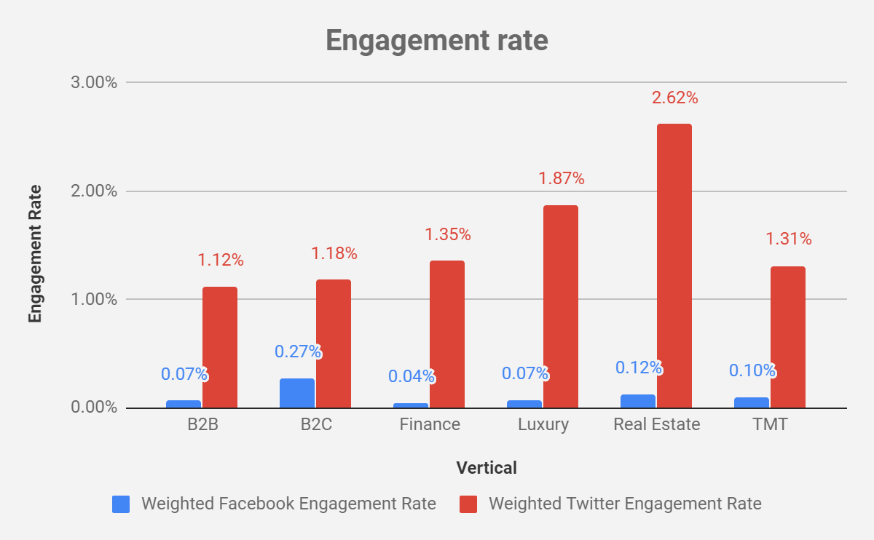
Facebook vs Twitter Engagement Rate
Notes:
Twitter has the better engagement rate on all verticals and this means that there were more likes, retweets and comments to ads on twitter. Facebook did very poorly and means ads were less engaged.
Worthy of note is that B2C did much better relatively on facebook compared to others who have similar facebook and twitter engagement rates. There was deliberate and could mean that the audience cares more about what B2C is showcasing.
Also, real estate has a very high ER and this means people care more about what they are showcasing on Twitter.

